Slide 1


ARTICLE 700 OF THE FRENCH CODE DE PROCEDURE CIVILE
Legal Data Analytics
Julien CARRANCE
Quentin DUPRE
Bertrand SABATHIER
Laurine LE
Monday, March 27th 2023

Slide 2


INTRODUCTION
Article 700 of the French Code de Procedure civile:
Allows to request before all courts of the judicial orders
The payment by the adversary
The sums incurred in the context of the procedure:
lawyer's fees, travel expenses, correspondence costs, etc.
The amount awarded is at the discretion of the judges

Slide 3


INTRODUCTION
Our main question:
Are there some differences in the award of amounts under Article 700 of the French Code de procédure civile among different Courts of Appeal ?

Slide 4

Our Assumptions
Larger amounts awarded by the Paris Court of Appeal under Article 700
Cases are more important in Paris in terms of the amounts at stake
Lawfirms fees are higher in Paris

Slide 5


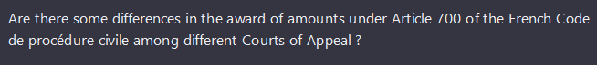
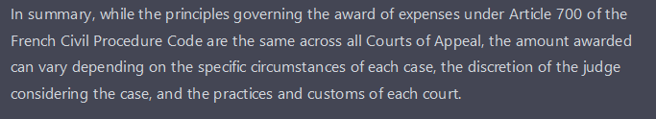
What does ChatGPT say about it?
According to ChatGPT, article 700 depends on:
The discretion of the judge
The circumstances of the case
The practices and customs

Slide 6
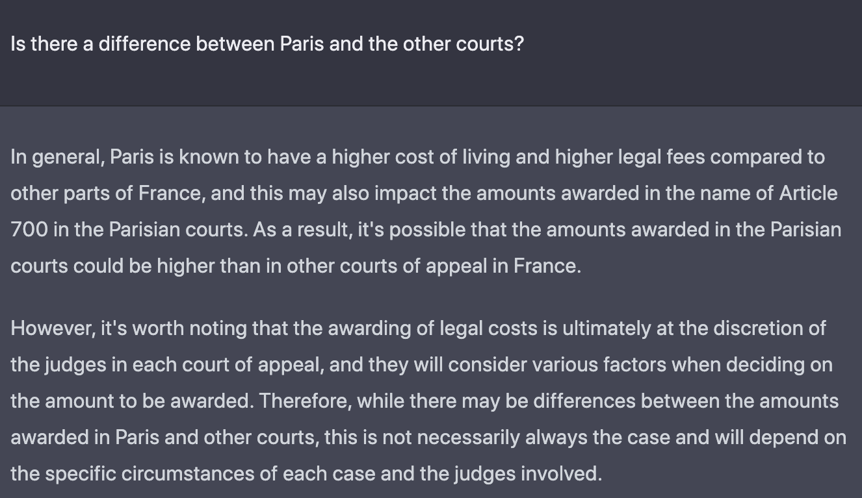
What does ChatGPT say about it?
The amounts awarded by the Paris Court of Appeal are generally higher than those awarded by other Courts of Appeal
Cost livings
Higher legal fees
6

Slide 7
What does Data say about that ?

Slide 8
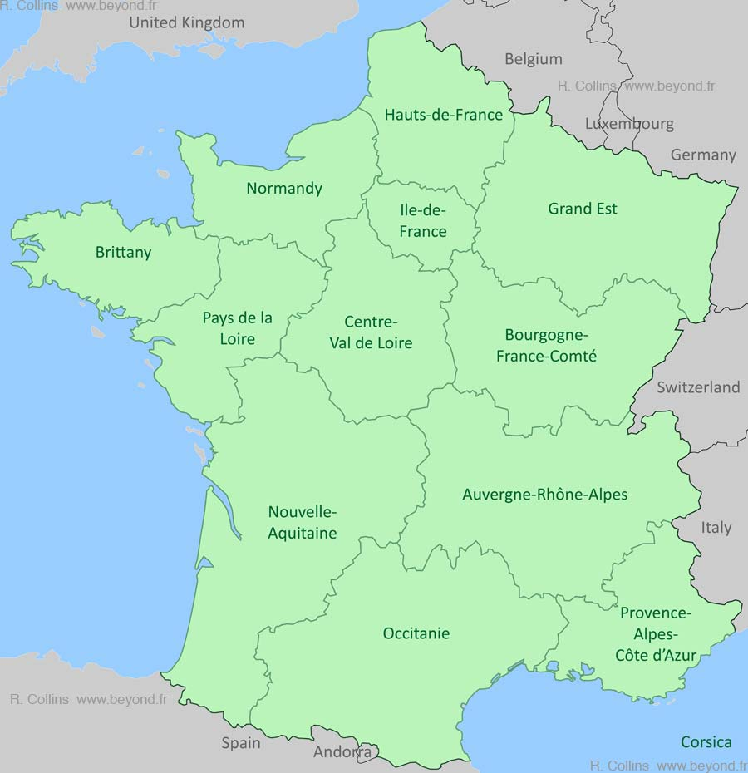
In Practice, how to select the Data ?
Extraction of 5 Courts of Appeal decisions from Judilibre
Timeframe: May 2022 to March 2023
Varied panel with the following courts:
Paris Court of Appeal
Versailles Court of Appeal
Toulouse Court of Appeal
Pau Court of Appeal
Riom Court of Appeal

Slide 9



AGENDA
What we have achieved to code :)
Our (biased) analysis

Slide 10

WHAT WE HAVE ACHIEVED TO CODE

Slide 11

The Big Picture – two basic loops
Loop 1
Getting a list of URLs links from the website JudiLibre
The point: having a useable dataset for the computer to use each link individually in loop 2
Loop 2
Using every link to access each decision for various Courts of Appeal
For each decision (each link), extract the relevant data points: Name of the Court of appel, judgment date and amount of money granted on the basis of Article 700

Slide 12

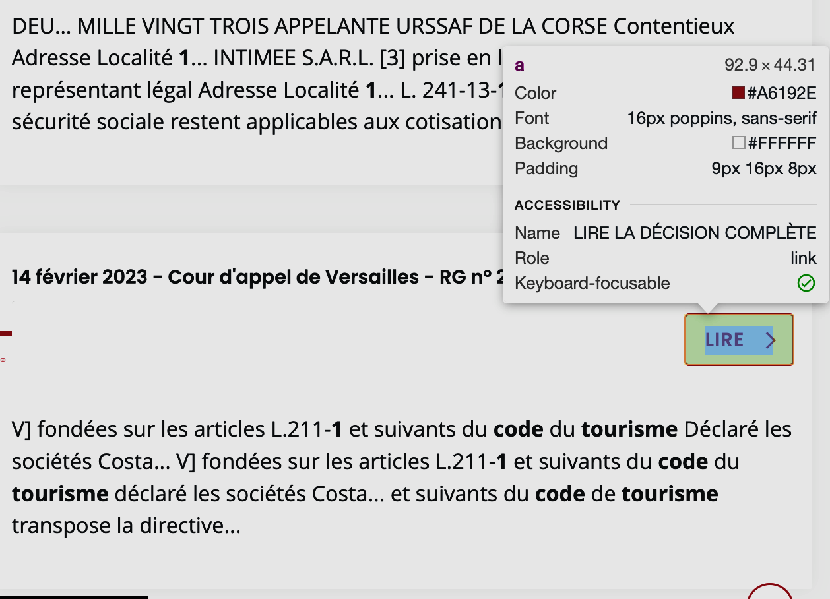
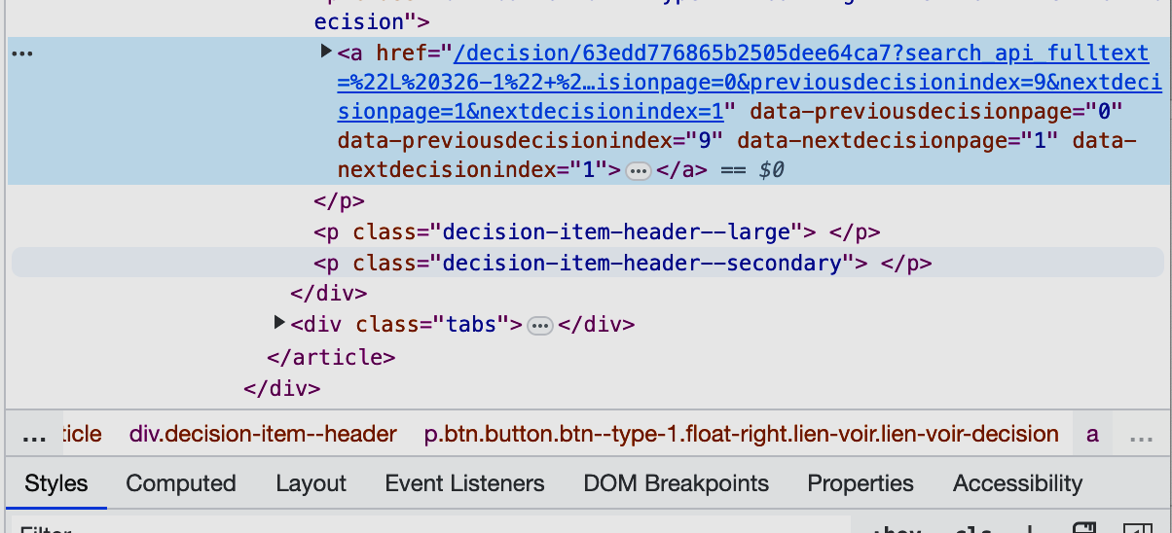
Loop 1 – Some explanations
A BASIC LOOP TO EXTRACT URL LINKS
Our goal: making a list of URLs from the « href »

Slide 13
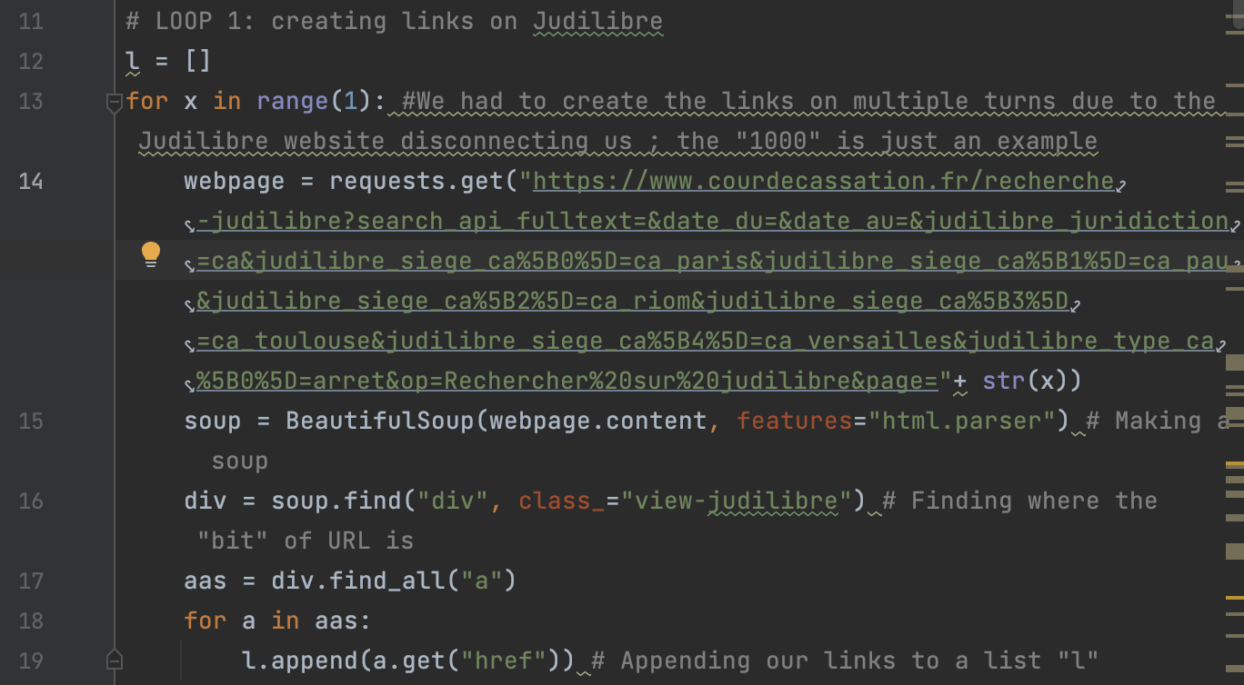
Loop 1 – Some explanations
A BASIC LOOP TO EXTRACT URL LINKS
Key steps:
Using the request function
Making a soup out of the menu webpage
Extracting the URL of the HTML structure
Duplicate the process for each decision, on every page
Making a list with all the « bits » of URLs

Slide 14
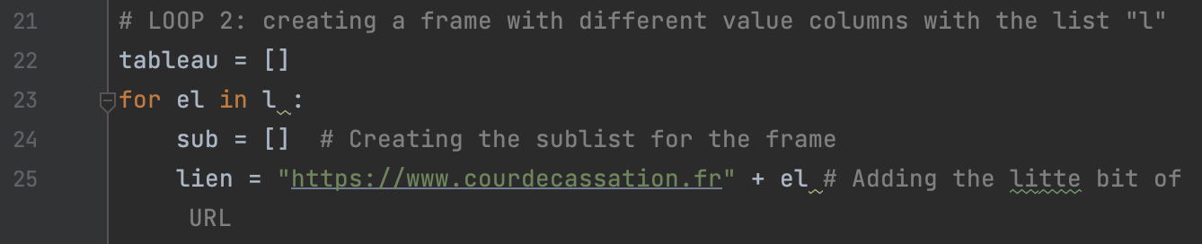
Loop 2 – Extracting data from each decision
STEP 1 – CREATE A SOUP and a frame for our data AND APPENDING LINKS

Slide 15
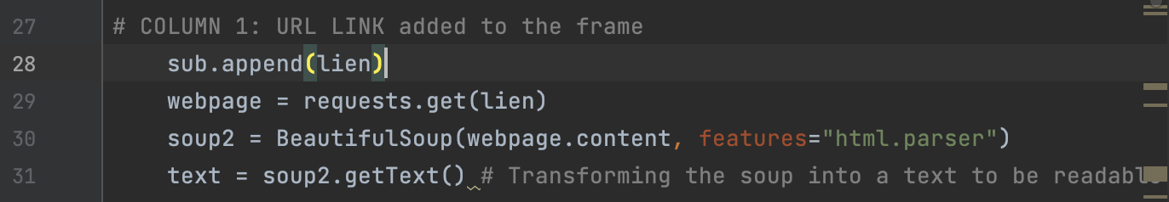
Loop 2 – Extracting data from each decision
STEP 1 – CREATE A SOUP and a frame for our data AND APPENDING LINKS

Slide 16
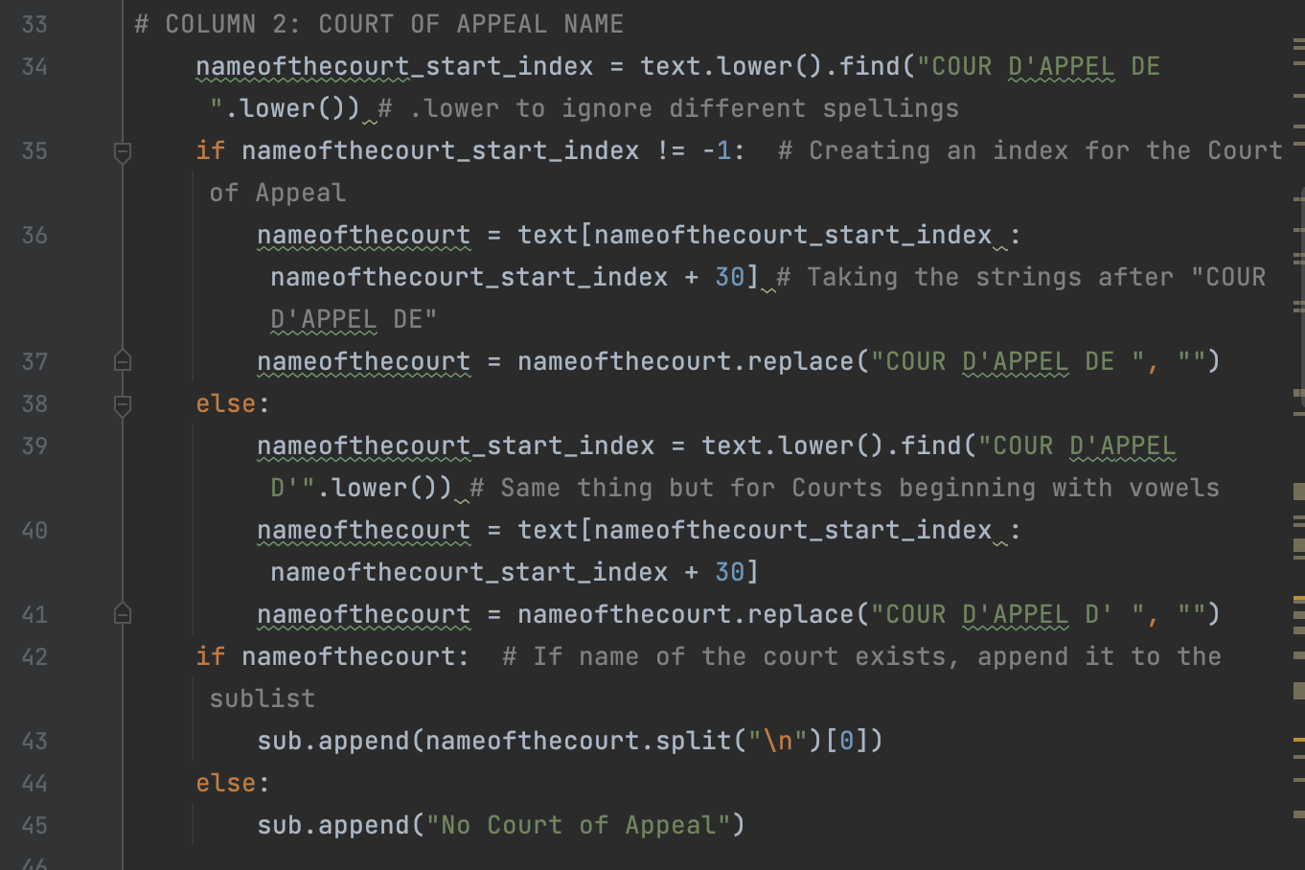
Loop 2 – Extracting data from each decision
STEP 2 – EXTRACT the name of the court
Key takeaways:
Check the mechanism: the role of the “else - no court of appeal”

Slide 17
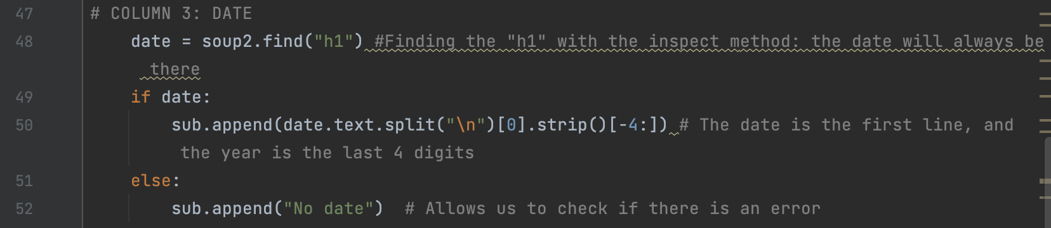
Loop 2 – Extracting data from each decision
STEP 3 – EXTRACT the date
Issue: we wanted to use the same method to find the date as the method we used for the Court of Appeal, starting with « ARRÊT DU » but a lot of human mistakes made it impossible to find the date in the text as such
Solution: we used the HTML structure to look for the date at the top of the page (in the header « h1 »)

Slide 18
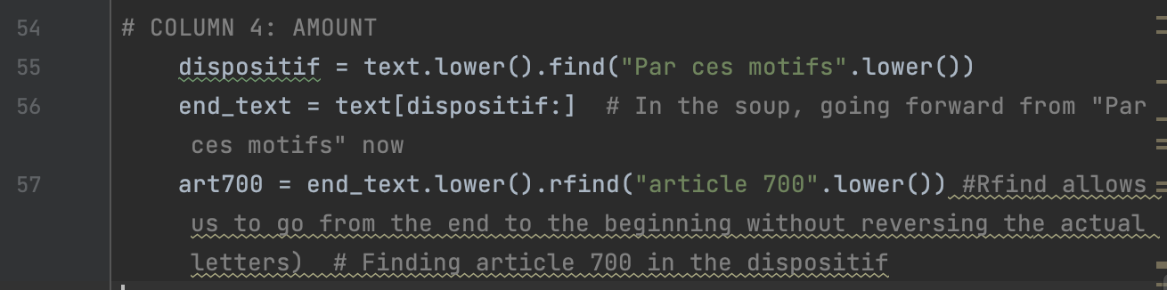
Loop 2 – Extracting data from each decision
STEP 4 – find the amount granted on the basis of article 700
Method used:
Identifying the lower part of the decision, called “Dispositif” in the soup
Identifying the “article 700” reference in the “Dispositif”

Slide 19
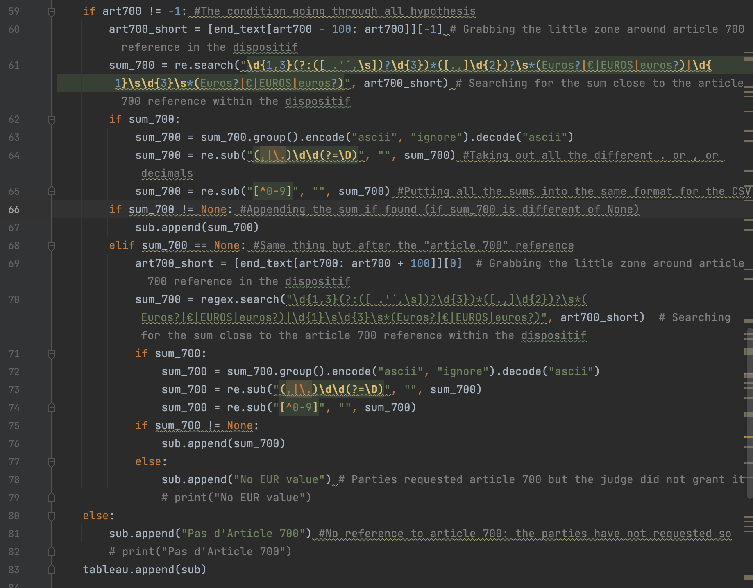
Loop 2 – Extracting data from each decision
STEP 4 – find the amount granted on the basis of article 700
Key takeaways :
Create a “perimeter” around the article 700 to identify and extract the amount through Regex
Using conditions to append the amount to the list:
Article 700 found: a sum of money
“No EUR value”
“No Article 700”

Slide 20
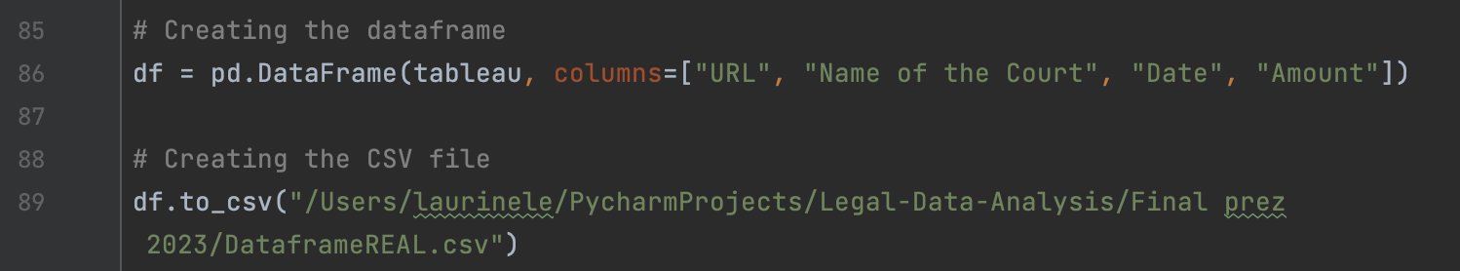
Loop 2 – Extracting data from each decision
STEP 5 – CREATING THE DATA FRAME

Slide 21
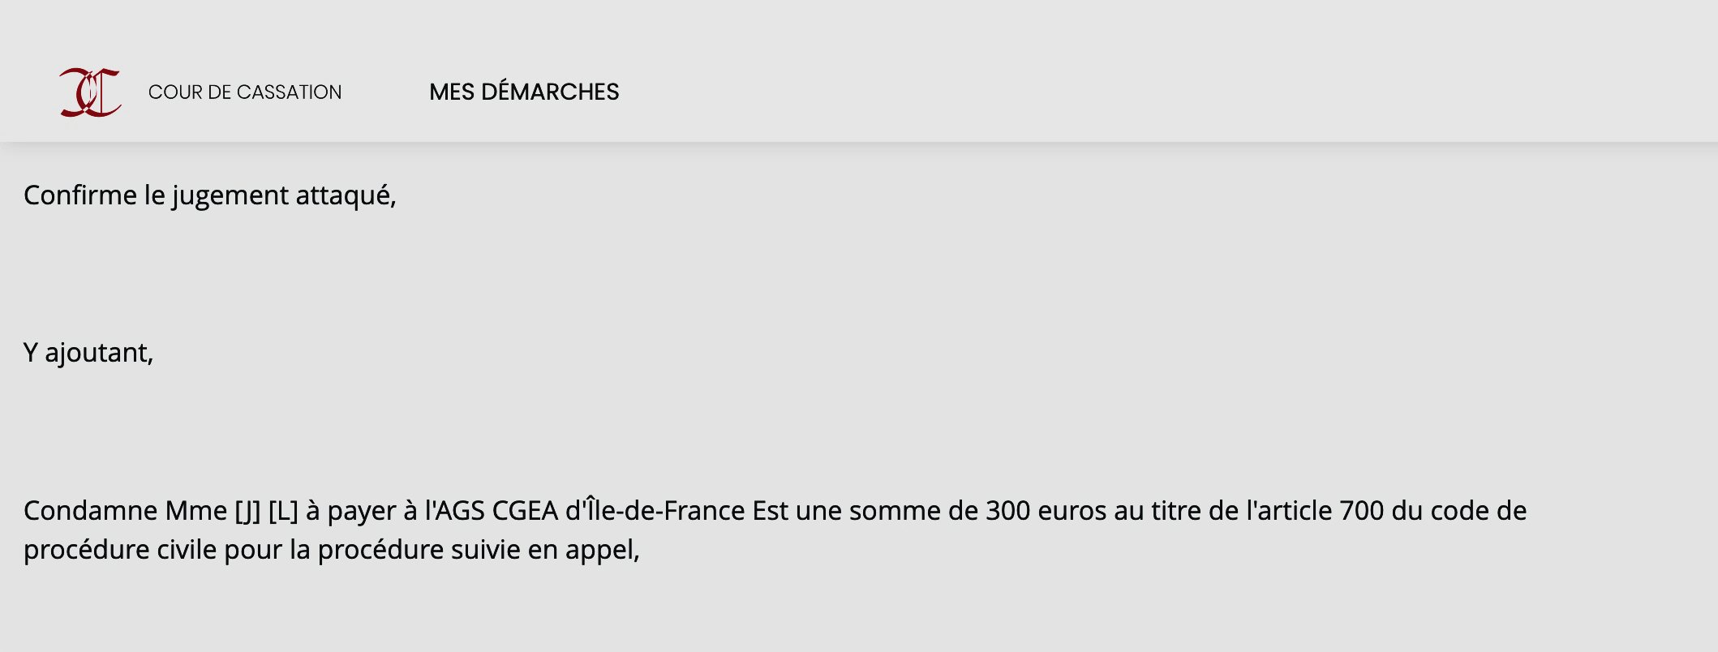
It works !

Slide 22

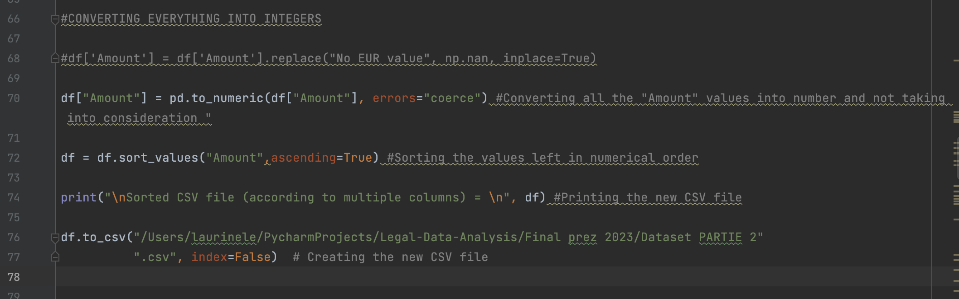

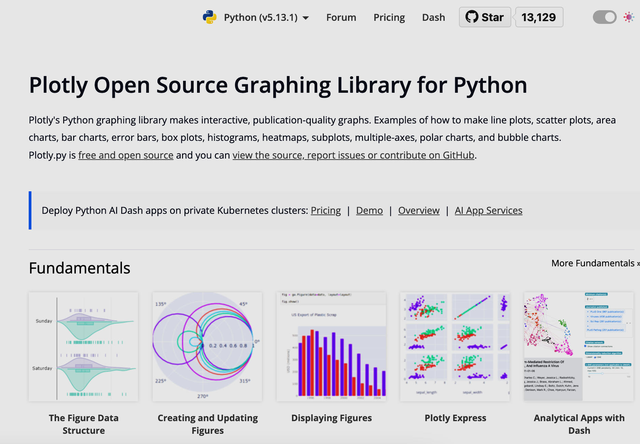
After having made the dataframe: the graphs !
We decided to use Plotly to create a number of graphs to help us analyze the dataset created from Judilibre

Slide 23
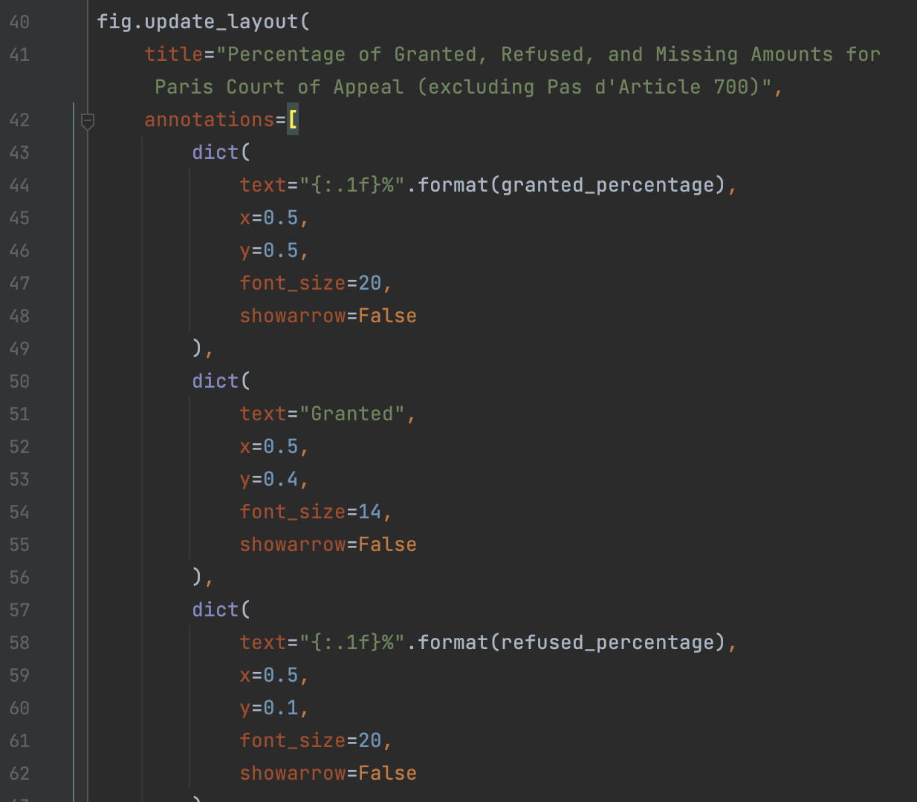
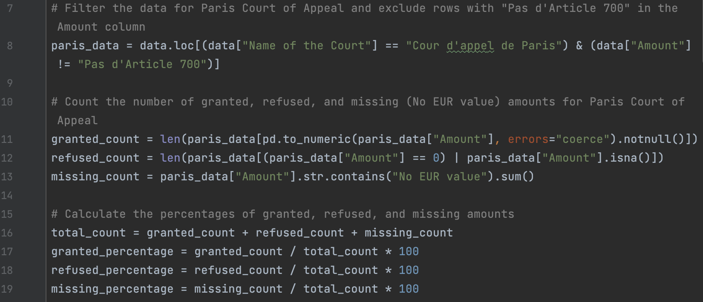
After having made the dataframe: the graphs !
Adjusting the data for the Plotly
A plotly example for the donut chart

Slide 24
OUR (BIASED) ANALYSIS

Slide 25
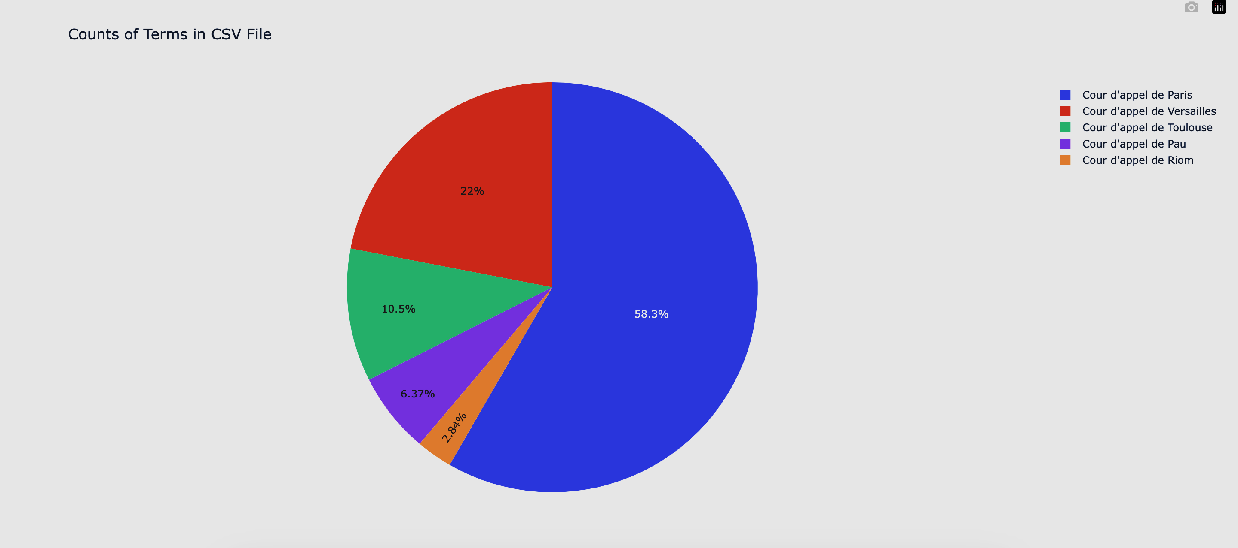
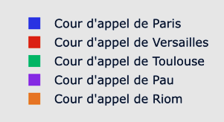
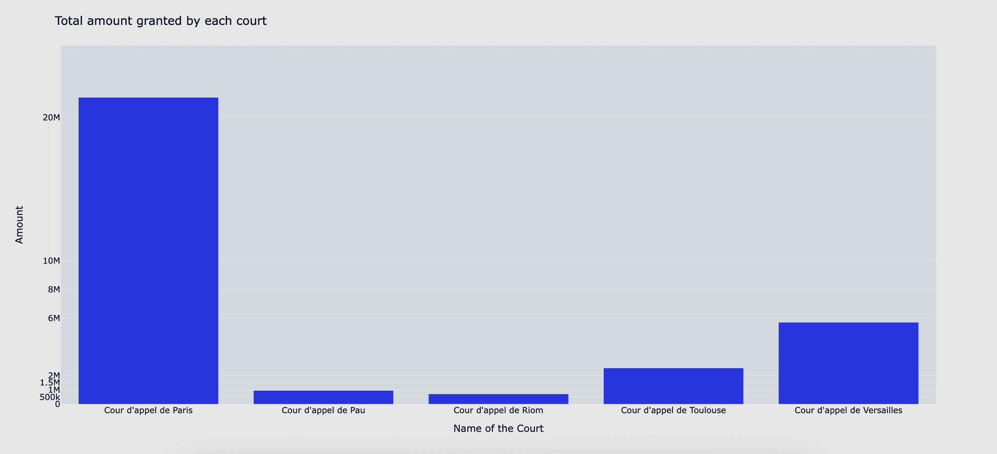
First look at the results
Distribution of the Courts of Appeal in the dataset
Number of extracted decisions from Judilibre : 24326
Paris Court of Appeal : 14190
Versailles Court of Appeal : 5343
Toulouse Court of Appeal : 2552
Pau Court of Appeal : 1549
Riom Court of Appeal : 692
Total amount allocated by each Court of Appeal
Logically, the Paris Court of Appeal is over-represented in the dataset because it rules on more decisions
Explains that the sum of the amounts awarded by the Paris Court of Appeal under Article 700 is much higher
Makes it necessary to reason in terms of mean and median to compare Courts of Appeal
Notes:
Quentin

Slide 26
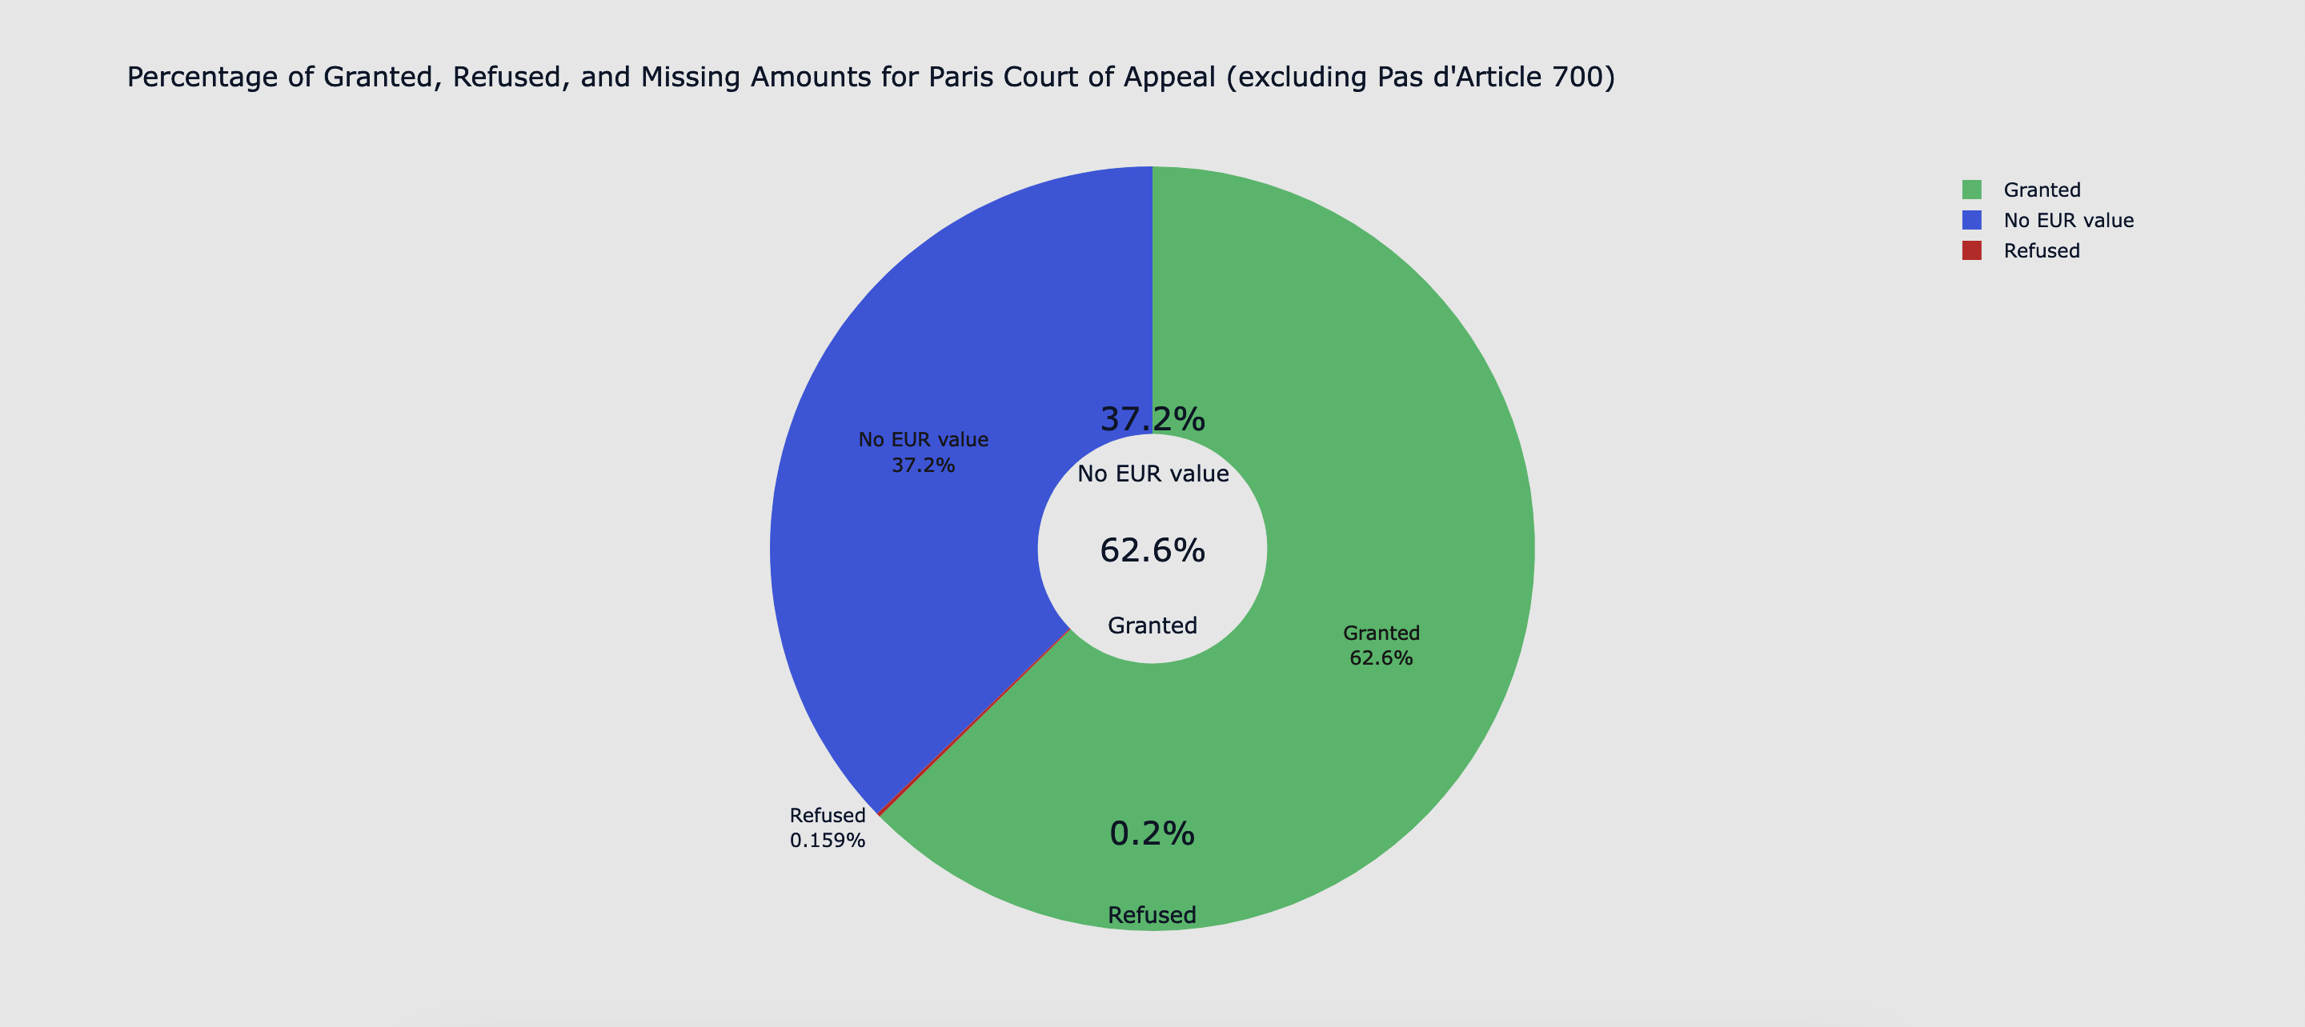

Focus on the Paris Court of Appeal
The Paris Court of Appeal grants amount on the basis of Article 700 in around 37,2% of its decisions
Notes:
Julien

Slide 27
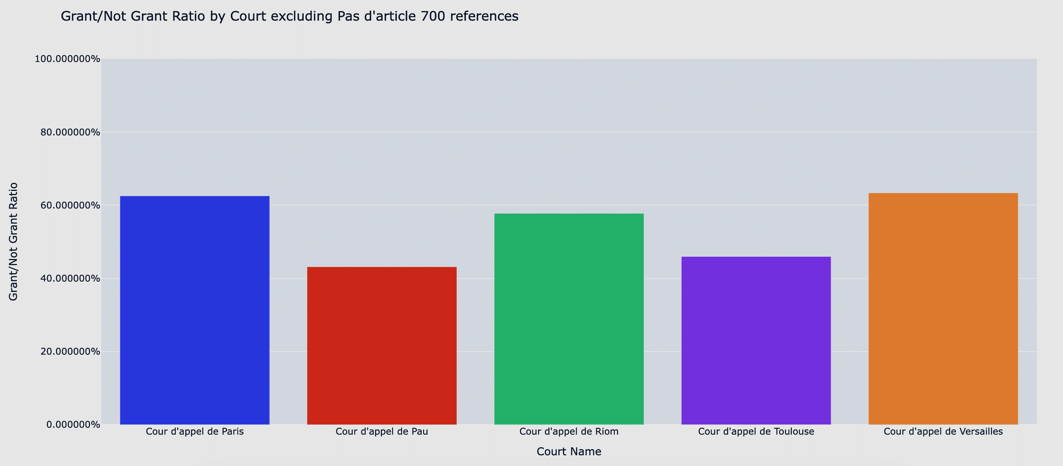
Are some Courts of Appeal more reluctant to award amounts under Article 700 ?
Notes:
Julien – même données que les camemberts mais présentées différement : en % les courst de petits ressorts accordent plus ?

Slide 28
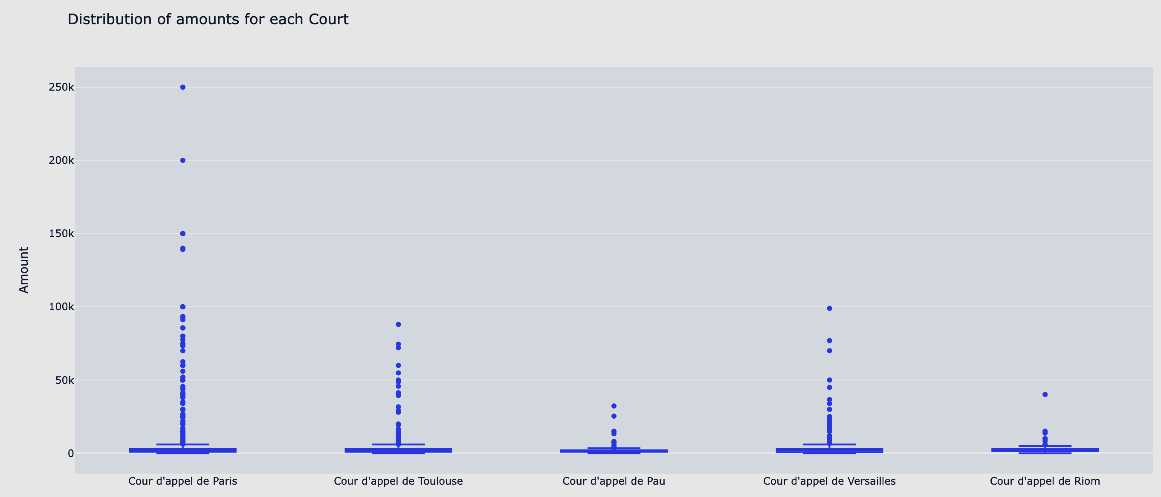
Distribution of the amounts allocated by each Court
Notes:
Julien – même données que les camemberts mais présentées différement : en % les courst de petits ressorts accordent plus ?

Slide 29
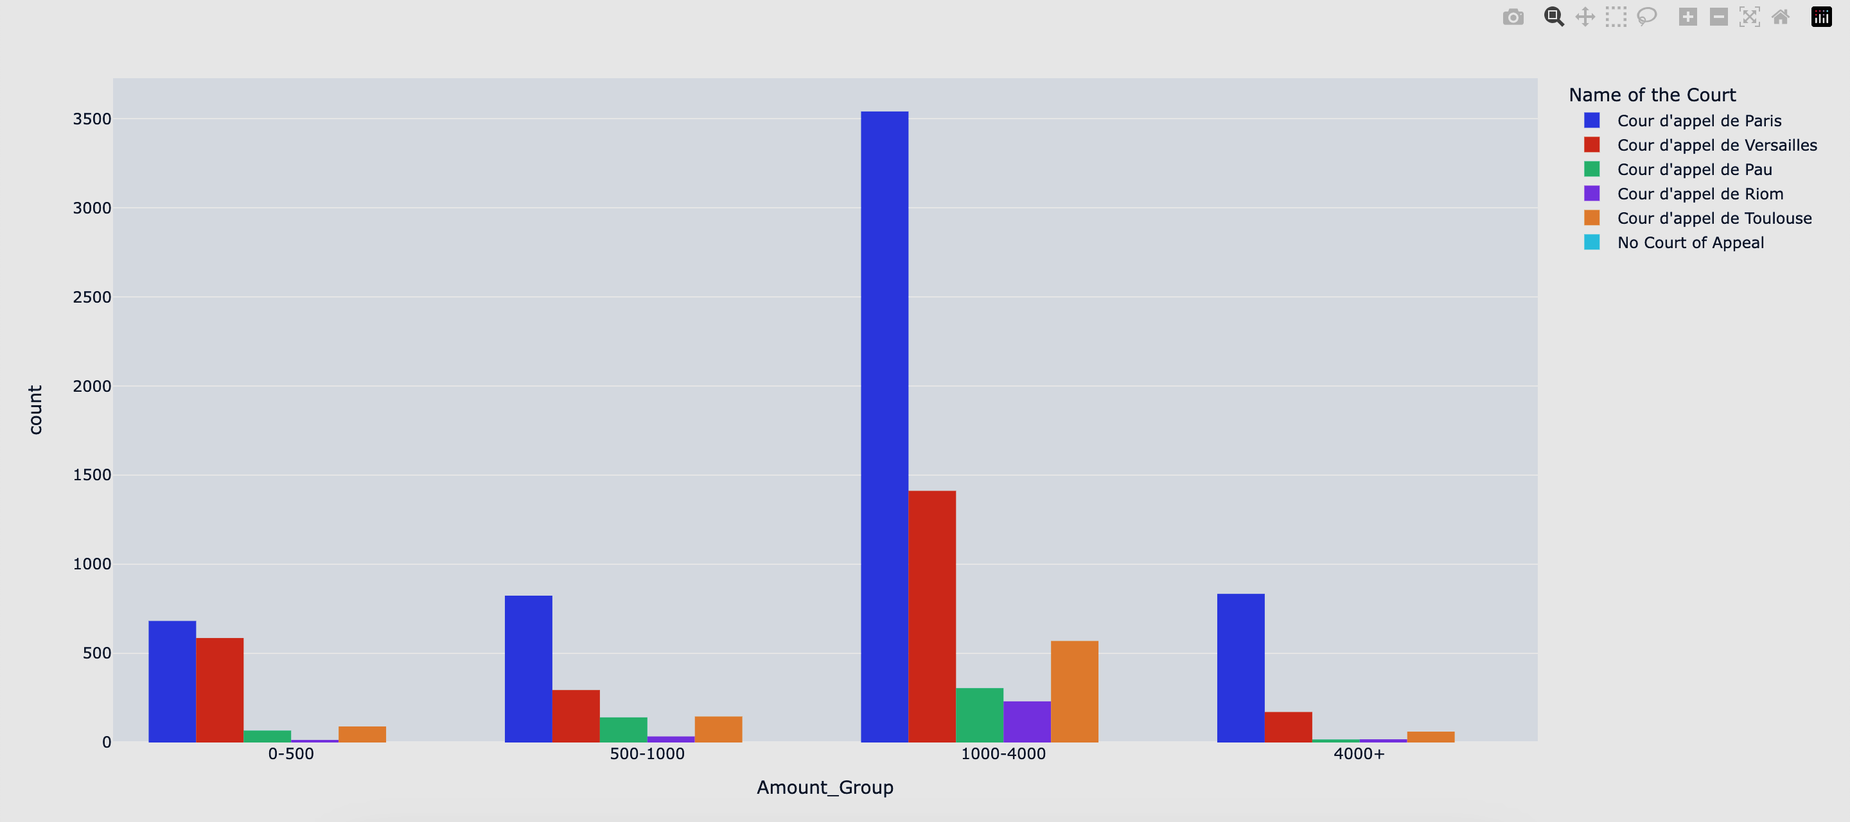
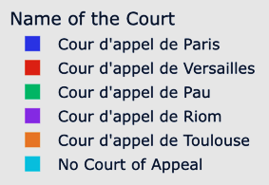
Distribution of the amounts awarded by the different Courts of Appeal
Notes:
Quentin → majorité de decision octroient entre X te Y ….

Slide 30
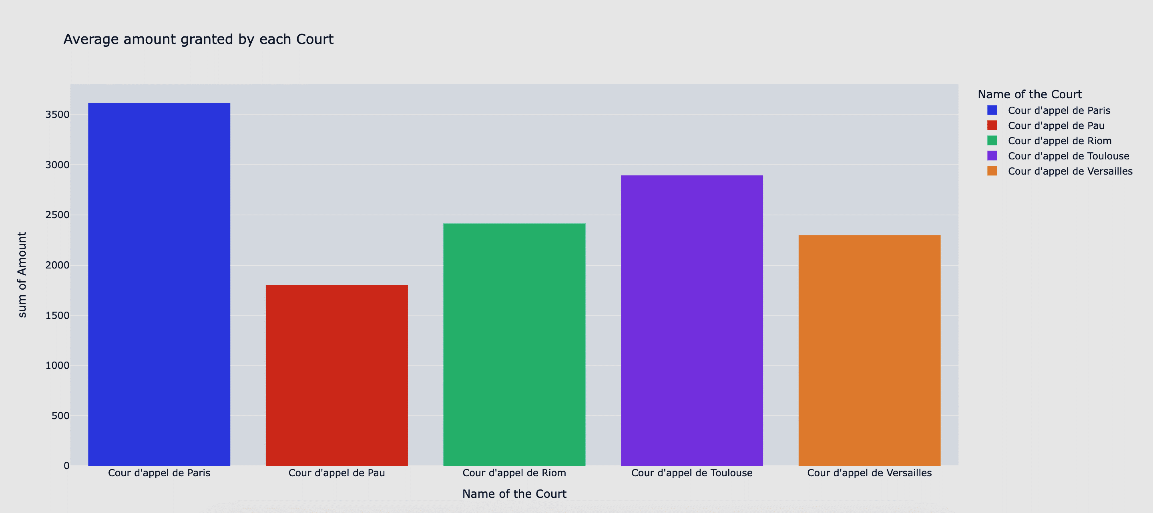
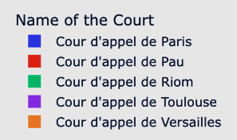
Comparison of the averaged amounts awarded by each courts of appeal
Notes:
Julien

Slide 31
Comparison of the averaged amounts awarded by each Court of Appeal
Paris has the highest average with 3500 euros
Pau has the lowest with 1700 euros
Notes:
Julien

Slide 32
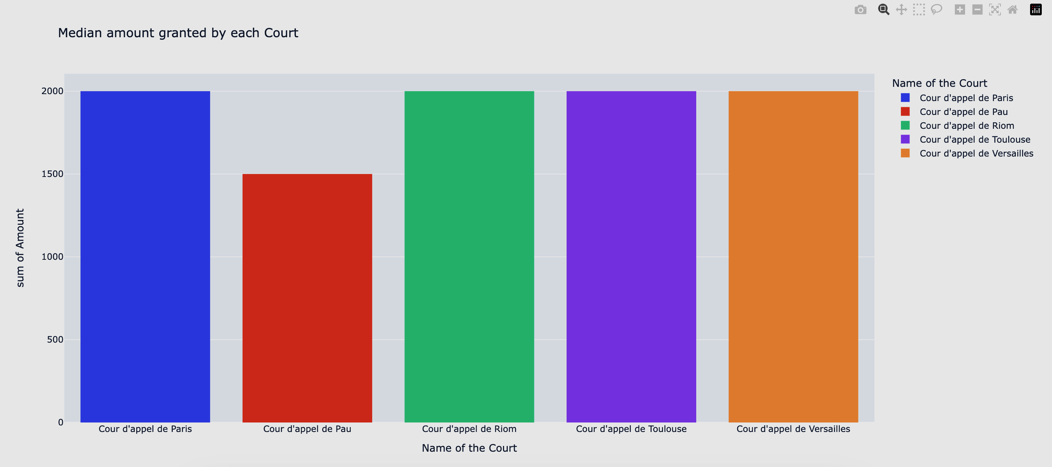

Comparison of the median amount awarded by each Court of Appeal
No, there is no mistake!
Uniformity of the median amounts
The median is not influenced by the extreme values!
If we take into account the decisions where no amount under Article 700 is granted: all the medians are equal to 0
Notes:
Quentin

Slide 33

CONCLUSION
Despite several difficulties…
… Our goal was achieved
No standardization of the decisions rendered by the Courts of appeal
Differences in the redaction (Amount granted, date, …)
Only 10 000 decisions per research on Judilibre, a website that looks like a beta version…
We extracted large quantities of decisions
We proved that ChatGPT was not wrong!
Our analysis could be performed on an even larger database, once Judilibre gets better!

Slide 34
Thank you! Any questions?
Legal Data Analytics
Julien CARRANCE
Quentin DUPRE
Bertrand SABATHIER
Laurine LE
Monday, March 27th 2023

